Slide 1
Myntra Analysis : Brand Perception and Market Trends
Shiyam Sundar S | MBE11

Slide 2
Introduction to Myntra Analysis
Leading Fashion E-commerce Platform:
- Myntra, an Indian fashion e-commerce company founded in 2007-2008, initially sold personalized gift items and is headquartered in Bengaluru, Karnataka.
- In May 2014, Myntra was acquired by Flipkart; the company was founded by Mukesh Bansal, Vineet Saxena, and Ashutosh Lawania..
Leading Fashion E-commerce Platform: Myntra.com is a top online fashion retailer in India, offering a wide range of clothing, accessories, and lifestyle products from major domestic and international brands.

Slide 3
MYNTRA’S BUSINESS MODEL
Business Type: | Operates on a B2C (Business to Consumer) model, directly selling products to end customers.
Product Sourcing: | Sources products from verified brands. Ensures quality checks before listing products on the platform.
Brand Partnerships: | Collaborates with over 6,000 fashion and lifestyle brands, including global and Indian brands such as Levi’s, H&M, Nike, Biba, and Mango.
Product Offering: | Caters to customers seeking global brands as well as emerging fashion trends.
Return Policy: | Provides a 30-day return policy, ensuring customer satisfaction.
Target Market: | Focuses on fashion-conscious consumers looking for diverse styles and brands.

Slide 4

MARKET POSITION AND GROWTH
Myntra holds a market share of 35-45% in India's fashion e-commerce market, with over 60 million monthly active users.
It is experiencing rapid growth, expanding into non-metro cities, and diversifying into beauty and home decor, while its catalog size and international brand portfolio continue to grow.
Myntra's Competitors are Ajio, Meesho, Amazon Fashion, Flipkart Fashion, Nykaa, etc.

Slide 5

GROWTH TRAJECTORY
Founded in 2007 by Vineet Saxena, Ashutosh Lawania, and Mukesh Bansal.
Acquired by Flipkart in 2014 for approximately Rs 2,000 crore.
Became India's largest online fashion store, offering a wide range of global fashion products.
Appeals to both Gen Y (Millennials) and Gen Z with trendy fashion options.
Offers a variety of fashion and lifestyle products for men, women, and kids.
Products include clothing, footwear, beauty products, home accessories, and more.
Positioned as a one-stop-shop for fashion in India

Slide 6
REVENUE MODEL OF MYNTRA FOR THE FINANCIAL YEAR 2023
Revenue from Marketplace Services (2023):
INR 17,812 million (approx. US$215 million).
Total Operating Revenue (FY 2023):
INR 43.75 billion (approx. US$3.9 billion), an increase from the previous year.
Revenue from Advertisements (2023):
INR 5,353 million (approx. US$65 million).
Revenue from Logistics (2023):
INR 19,915 million (approx. US$240 million).
These revenue streams highlight Myntra's strong financial performance through logistics, marketplace services, and advertising income.

Slide 7
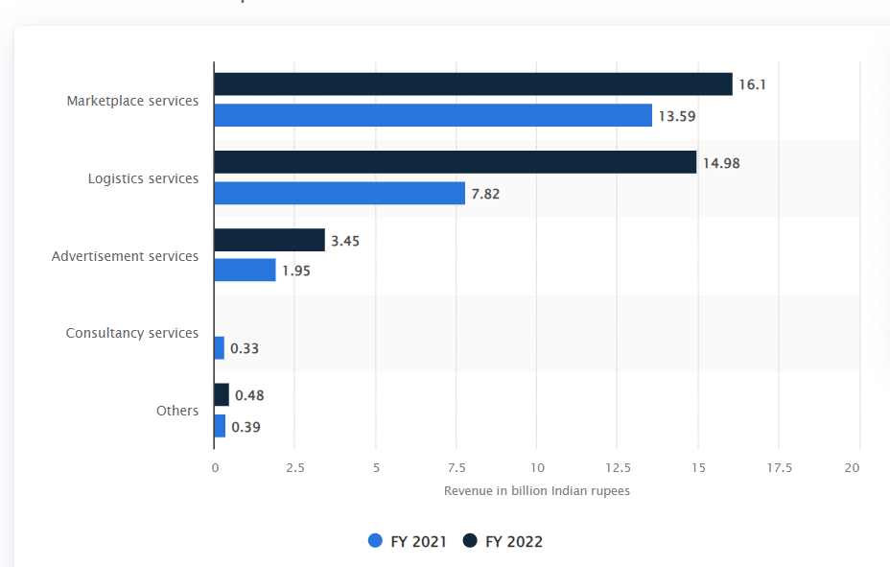
BREAKDOWN OF REVENUE OF MYNTRA OF FINANCIAL YEAR 2021 AND 2022

Slide 8
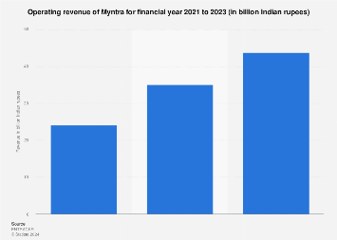
OPERATING REVENUE FOR FINANCIAL YEAR 2021 TO 2023

Slide 9
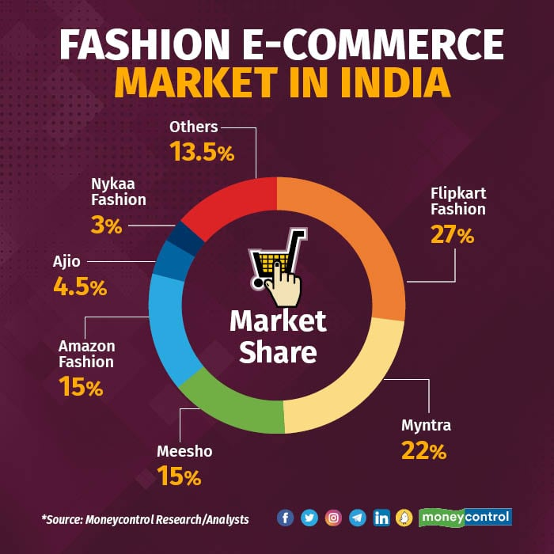
ONLINE FASHION STORES COMPARABLE TO MYNTRA

Slide 10

Myntra's Technology Impact (Rapid and AI-Powered Fashion):
Rapid Project:
AI-Powered Fast Fashion:
Consumer Data Utilization:
Moda Rapido & Here and Now Brands:
Launched to speed up the fashion production process using AI, high-end GPUs, and in-house engineering, enabling fast, high-quality, low-cost designs.
Myntra uses AI to create and deliver fashion trends quickly, reducing production time from 180 days to just 45 days..
Myntra leverages vast consumer data to understand fashion preferences, helping its AI design relevant and trendy clothes.
AI designs products for these brands, automating much of the process with minimal human supervision.
Tech and Supplier Collaboration:
Myntra’s strong partnerships with manufacturers and suppliers enhance the success of AI-driven fashion

Slide 11




SWOT Analysis of Myntra
Strengths:
Opportunities:
Weaknesses:
Threats:
Strong Brand Recognition
Large Product Range
Data-Driven Personalization
Robust Supply Chain.
Expansion into New Markets
Investment in Technology
Collaboration with Emerging Brands
Sustainability Initiatives
Customer Service Issues
Return and Refund Challenges
Quality Control Concerns
Dependence on Technology
Intense Competition
Changing Consumer Preferences
Economic Slowdown
Regulatory Challenges

Slide 12
CUSTOMER REVIEW ANALYSIS
MEDTHODOLOGY:
The Qualitative content analysis approach is used
Gathered reviews from customers about Myntra through various social media platforms, focusing on their experiences regarding product delivery, customer service, and return policies.

Slide 13
Findings of Myntra Reviews Impact Analysis
High Impact Reviews:
Customer Fraud Allegations: Several customers report receiving wrong products and poor refund processes, accusing Myntra of scamming. One user details a long-standing issue with customer support, describing it as "mental harassment" and urging a boycott.
Persistent Delivery Issues: Multiple reviews mention non-delivery of prepaid orders, with customers feeling ignored and frustrated by the lack of resolution. One user emphasized their loss of trust due to repeated delivery failures.

Slide 14
Medium Impact Reviews:
Mixed Experiences: Some users report decent return policies but express concern over product quality discrepancies, indicating inconsistency in their shopping experience.
Pathetic Customer Service: A few customers voice frustrations over unhelpful customer support that fails to resolve issues in a timely manner, leading to dissatisfaction.
Low Impact Reviews:
General Complaints: Some reviews mention specific product issues or minor inconveniences with returns, but lack the urgency or emotional weight of the more severe complaints.
Praise and Critique Mix: A handful of users share mixed feelings, noting both positive experiences and areas for improvement, but without strong negative sentiments.

Slide 15
Competitive Analysis of Myntra's Competitors in India's Fashion E-commerce Market
Myntra Competitors:
Ajio Meesho Amazon Fashion Flipkart Fashion Nykaa
Product Range:
Myntra: Wide range of curated, trendy, and international brands across categories.
Competitors: Amazon and Flipkart offer a larger general selection, but with less focus on fashion-first brands. Ajio and Nykaa have unique, premium collections but smaller in size.
Target Audience:
Myntra: Appeals to both mass-market and premium, fashion-conscious consumers.
Competitors:
Amazon/Flipkart target mass-market shoppers with affordability.
Nykaa and Tata CLiQ focus on premium and high-end customers.
Meesho targets budget-conscious buyers in smaller cities.

Slide 16
Pricing Strategy:
Myntra: Balanced approach with both affordable and premium options.
Competitors:
Flipkart and Meesho focus on discounts and affordability.
Ajio and Tata CLiQ lean towards premium pricing.
Amazon is generalist, offering both low and high-end products.
Brand Partnership:
Myntra: Strong partnerships with global and domestic fashion brands.
Competitors: Ajio focuses on unique collections, Nykaa and Tata CLiQ offer premium, curated brands, while Amazon/Flipkart have more general sellers.
User Experience:
Myntra: Fashion-first shopping experience with a focus on ease of use and customer engagement.
Competitors: Amazon and Flipkart are more functional but less fashion-oriented. Ajio and Tata CLiQ offer a stylish, premium experience, while Meesho relies on social commerce for smaller buyers.

Slide 17
Customer Service & Delivery:
Myntra: Known for reliable delivery and decent customer service.
Competitors: Amazon and Flipkart excel in delivery and returns, while Ajio, Nykaa, and Tata CLiQ are still growing their logistics networks.
Marketing Strategy:
Myntra: Influencer-driven campaigns, app-based promotions, and seasonal sales.
Competitors:
Flipkart focuses on discounts and sales.
Ajio and Nykaa are stylish, brand-focused with digital marketing.
Meesho leverages social selling and resellers

Slide 18
Strategic Recommendations for Myntra:
Strengthen Customer Support: Implement dedicated escalation teams and a real-time complaint tracking system for faster resolutions.
Improve Delivery Accuracy: Collaborate with delivery partners to ensure timely, accurate shipments and introduce an AI-powered tracking system.
Enhance Refund/Return Policies: Simplify and automate refund/return processes with faster, transparent resolution timelines.
Focus on Product Quality: Implement stricter quality control and improve product descriptions to match customer expectations.
Proactive Fraud Prevention: Create a fraud prevention team to handle claims and increase transparency in resolving issues.
Launch a Loyalty Program: Offer priority customer support and benefits through a loyalty program to retain customers.
Leverage Customer Feedback: Use customer feedback for operational improvements and publish updates on changes.
Improve Communication: Ensure clear, transparent communication with automated updates for deliveries, returns, and complaints.

Slide 19
Thank You

